Slide 1


Voice communication system for a spacesuit simulator
Design and performance estimation of the system with additional analysis of the usability on Mars
Omar Filip El Sendiouny

Slide 2
Overview
Introduction
Voice communication system and its compononents
System design
Results
Martian application
Conslusion
References

Slide 3
Introduction – Aim & deliverables
Design a backup voice communication system for the Serenity spacesuit simulator by taking table 1 into account.
If a repeater is necessary, design a self-sufficient energy distribution system for it.
Carry out performance estimation based on the design.
Investigate Martian application.
Range | 15km
Dimensions | Must fit inside the HUT.
Operating temperature within the HUT | 5°C to 45°C
Combined mass within the HUT | 1000g
Table 1: Requirements

Slide 4
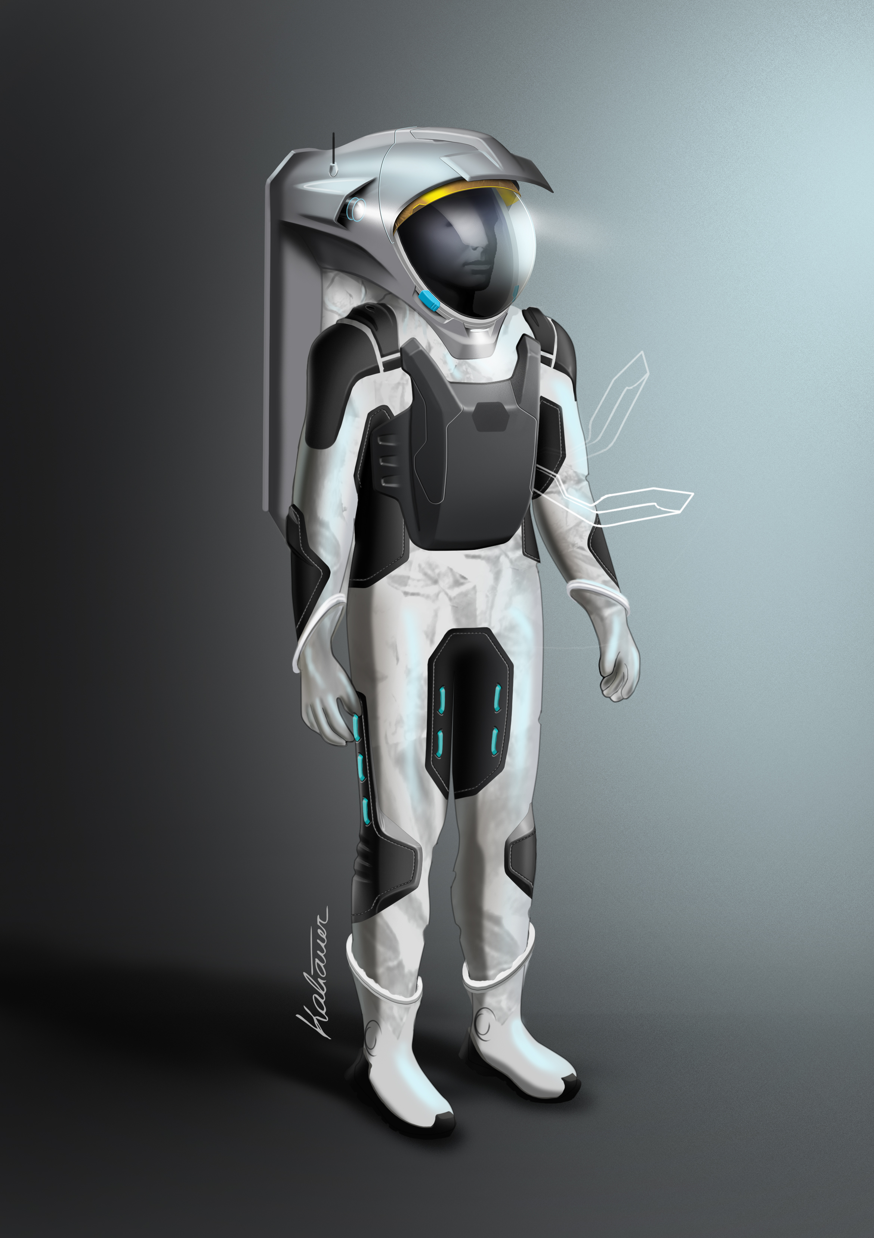
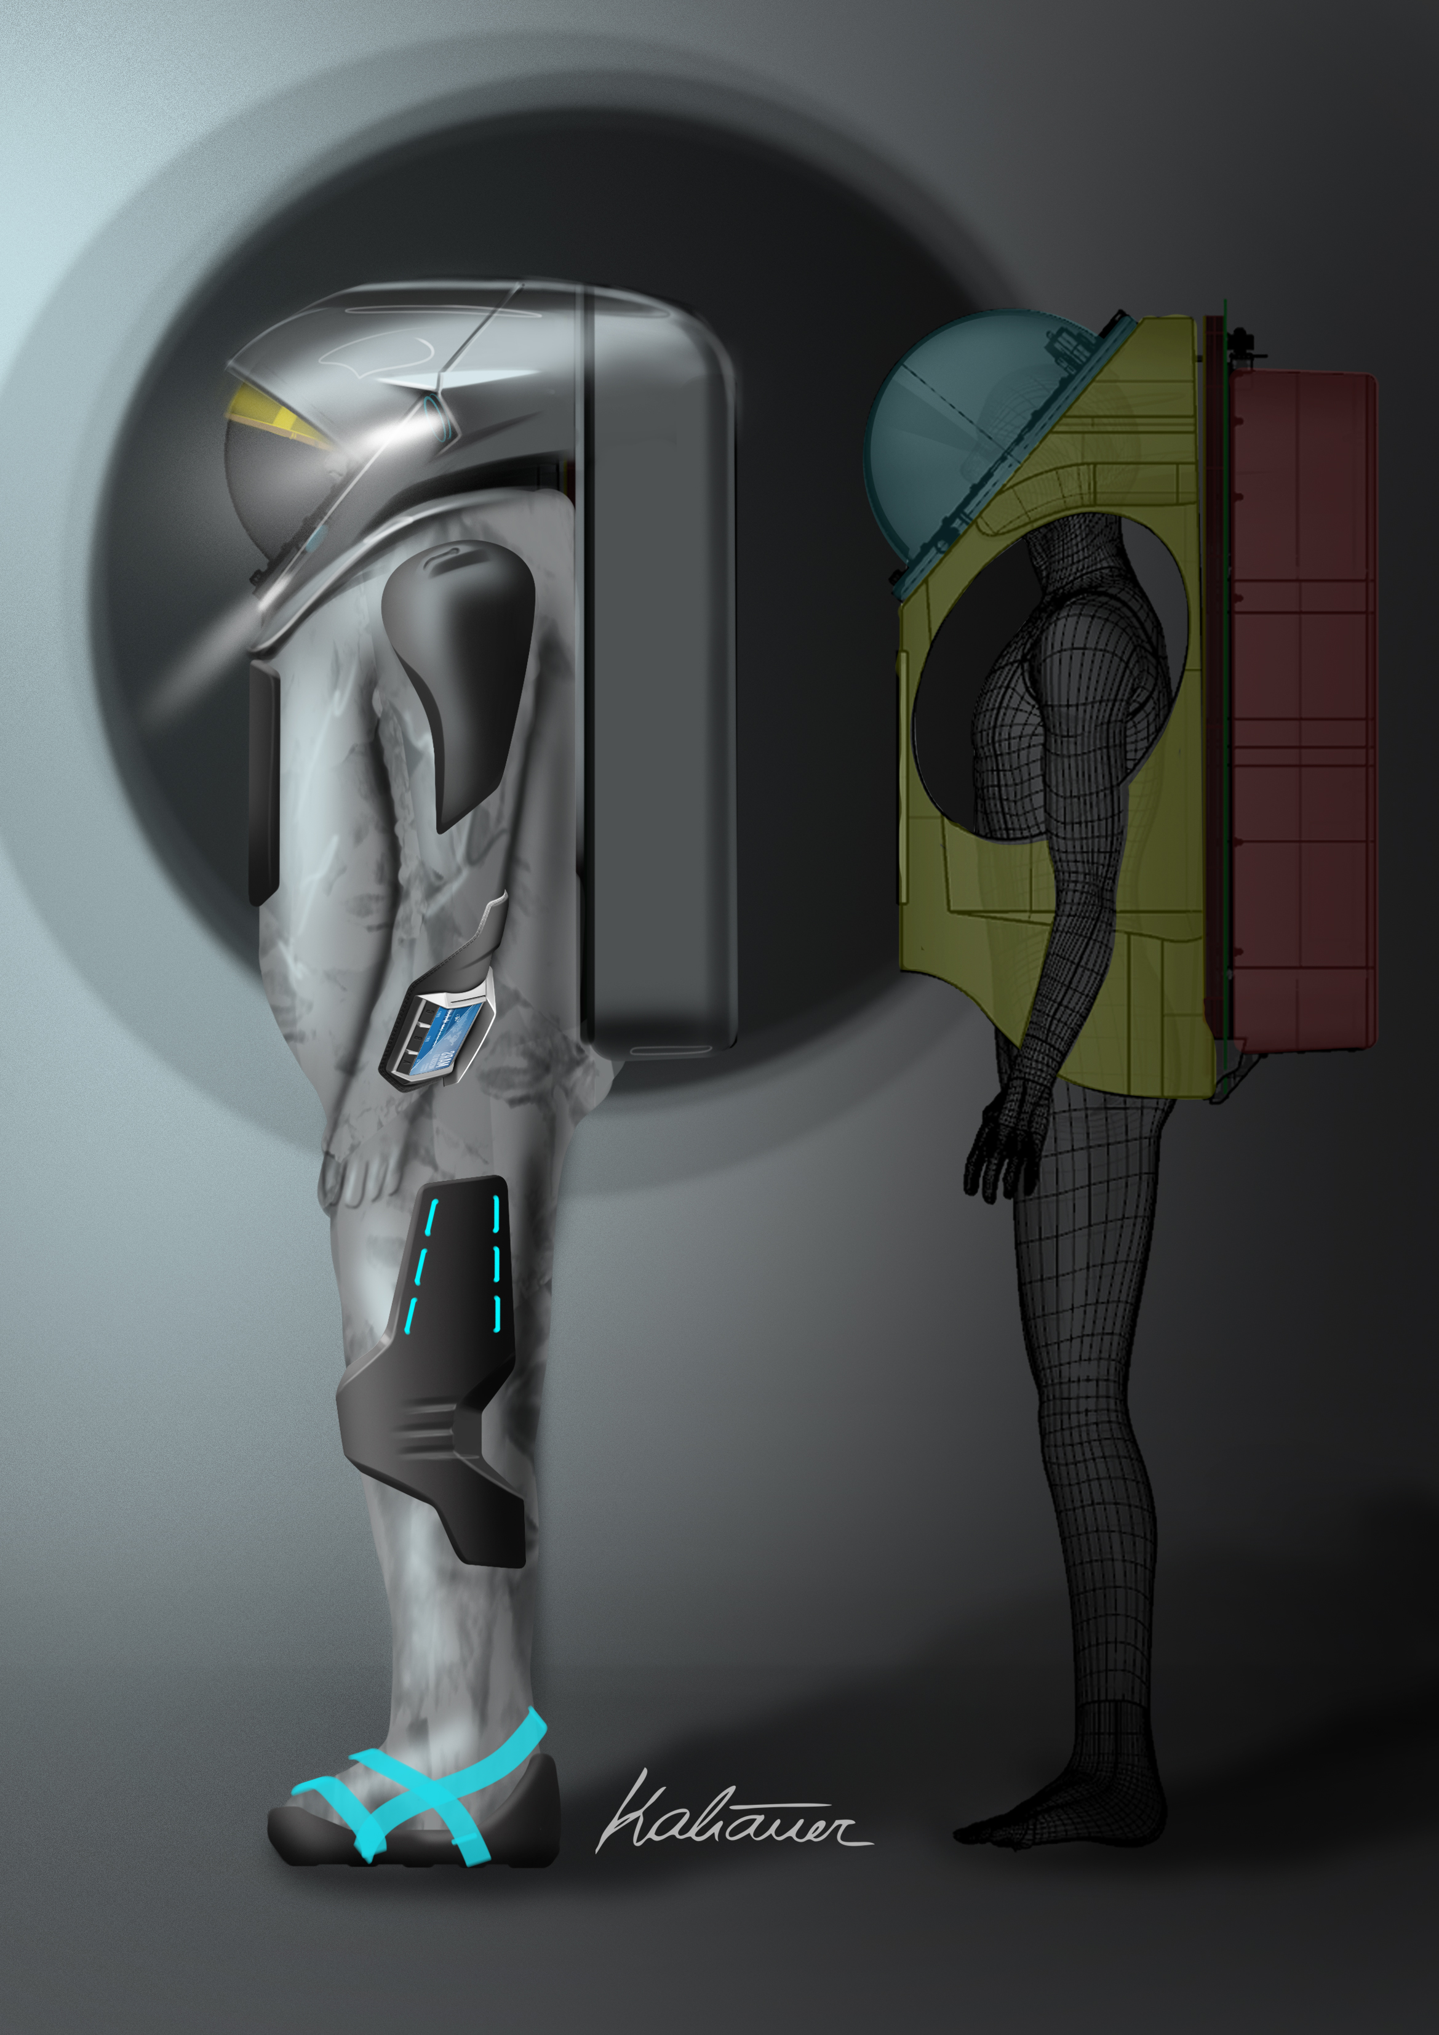
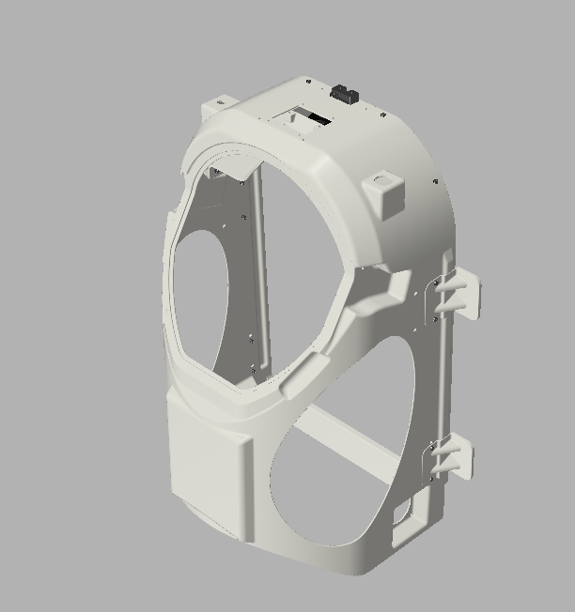
Introduction – About the thesis
Hard upper torso (HUT)
Antenna pass through
Figure 1: (Left and center) Serenity spacesuit simulator design study. (Right) CAD drawing of
the HUT. (Image credit: OeWF/Bernhard Kaliauer Design Studio and OeWF/Matthias Mair)

Slide 5
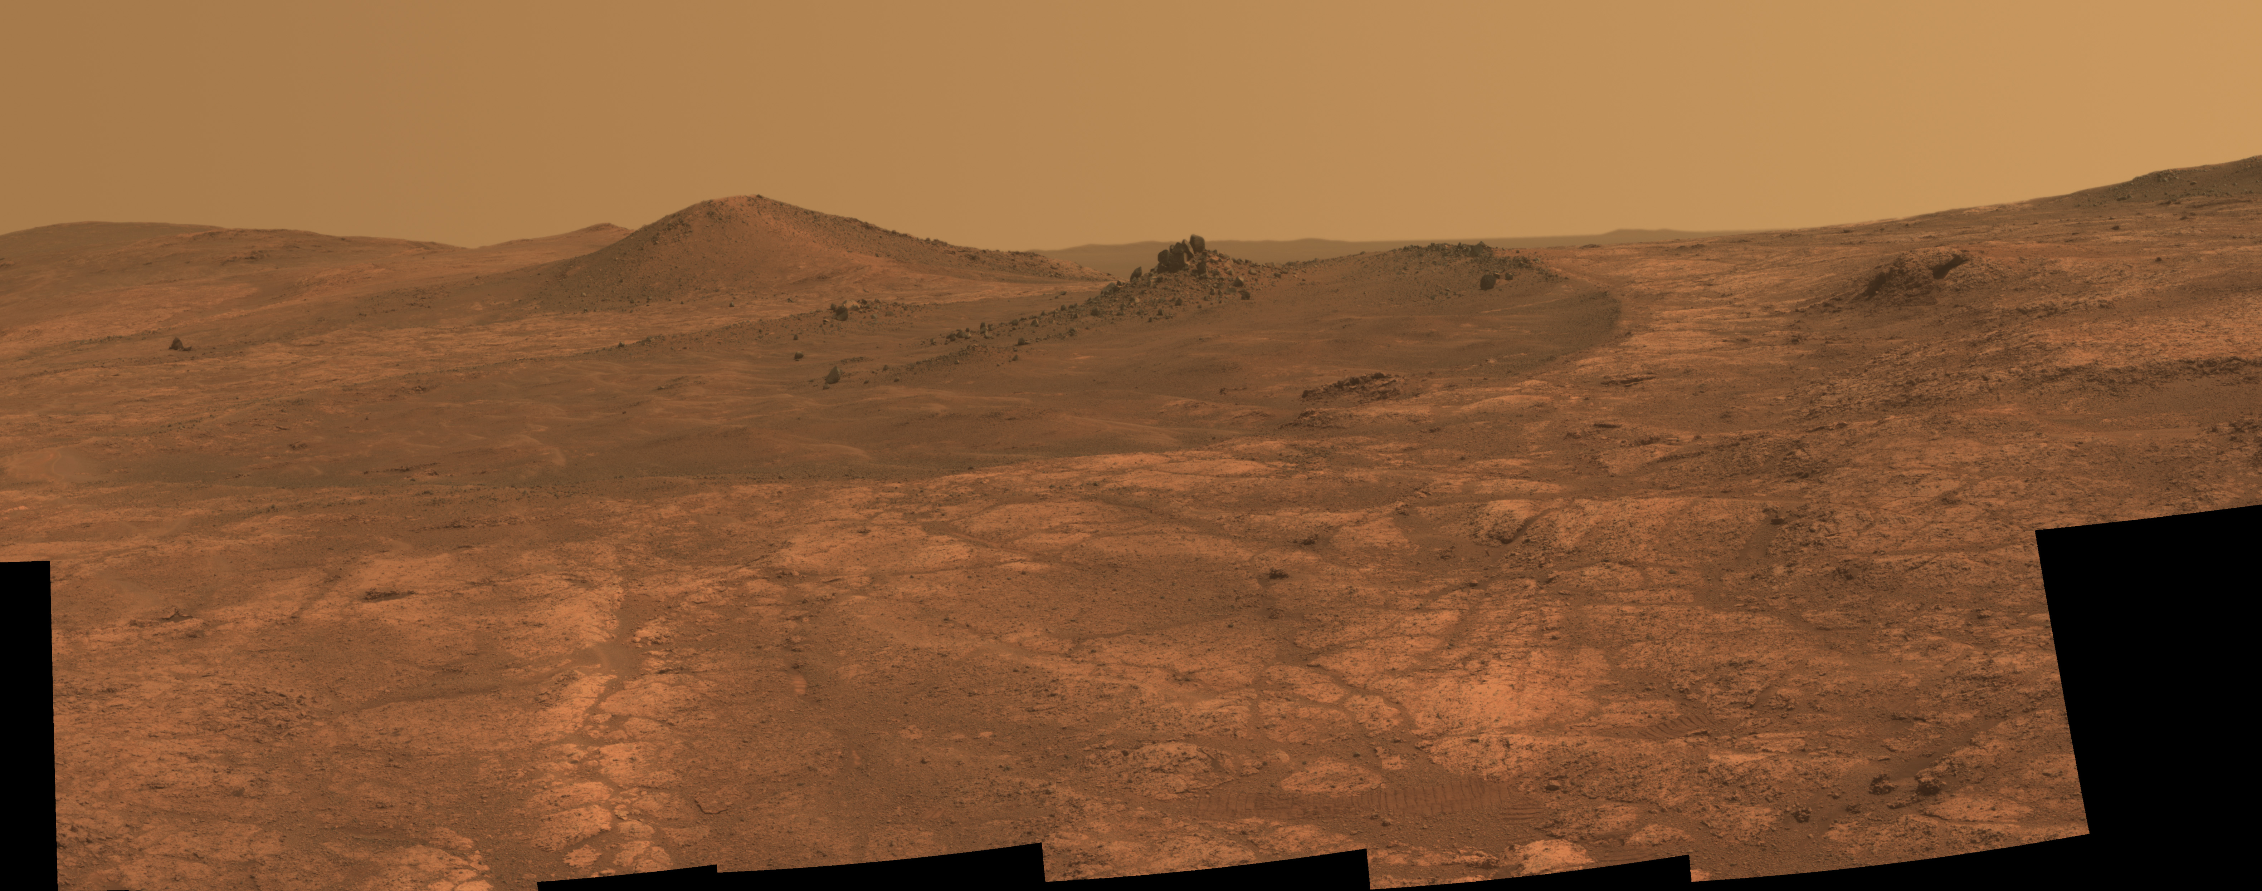
Introduction – About the thesis
Figure 2: Elongated crater ‘‘Spirit of St. Louis’’ on Mars. (Image credit: [1])

Slide 6
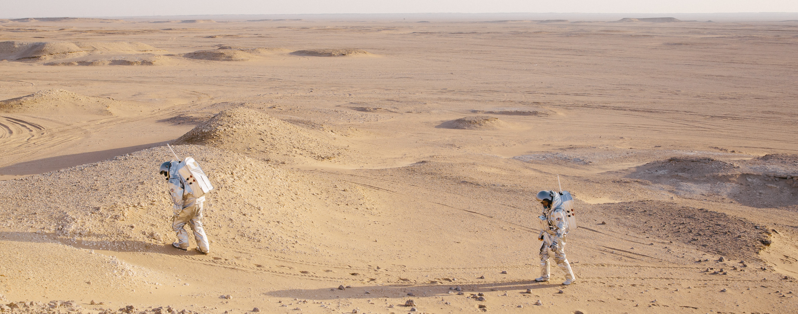
Introduction – About the thesis
Figure 3: Analog astronauts with the OeWF spacesuit simulator Aouda in the Dhofar Desert in
Oman. (Image credit: OeWF/Florian Voggeneder)

Slide 7
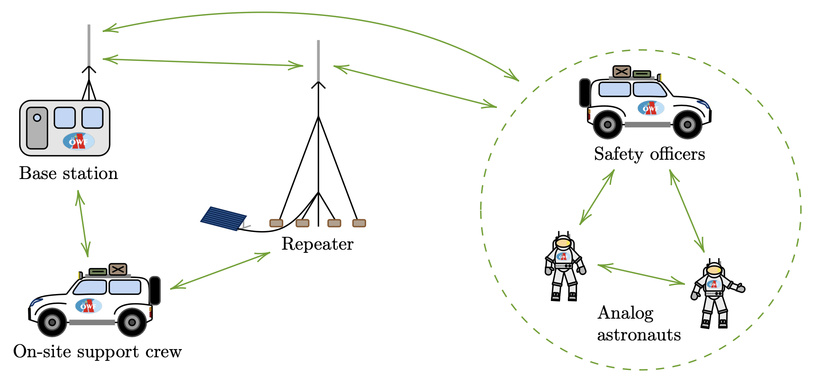





Voice communication system
Figure 4: System design of the backup voice communication system for the Serenity spacesuit
simulator.

Slide 8

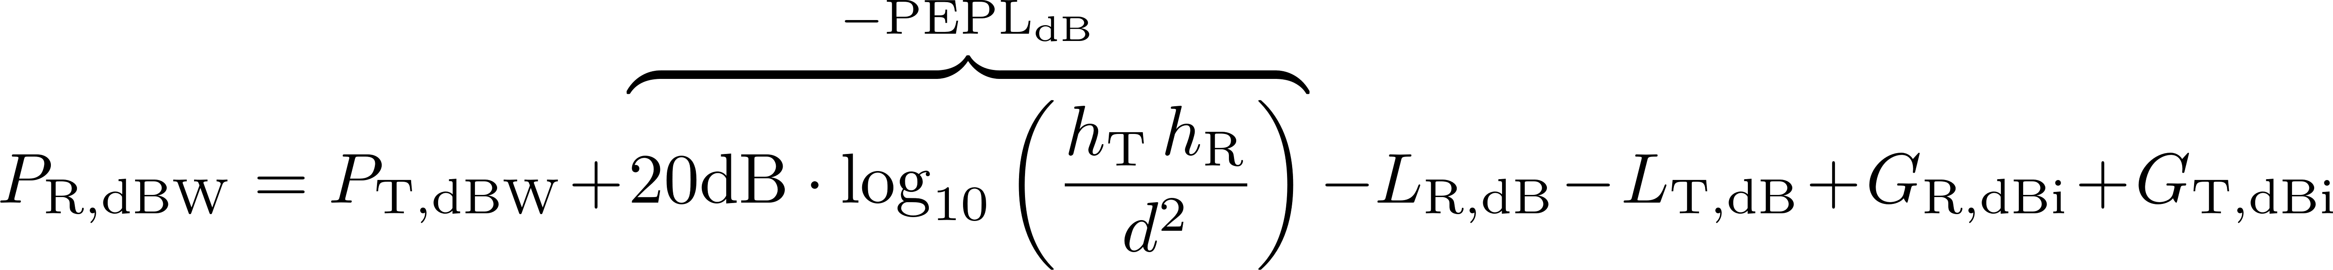
Voice communication system
Mesh topology with digital voting
System frequency (VHF)
Motorola Mototrbo infrastructure
Plane earth propagation equation:

Slide 9
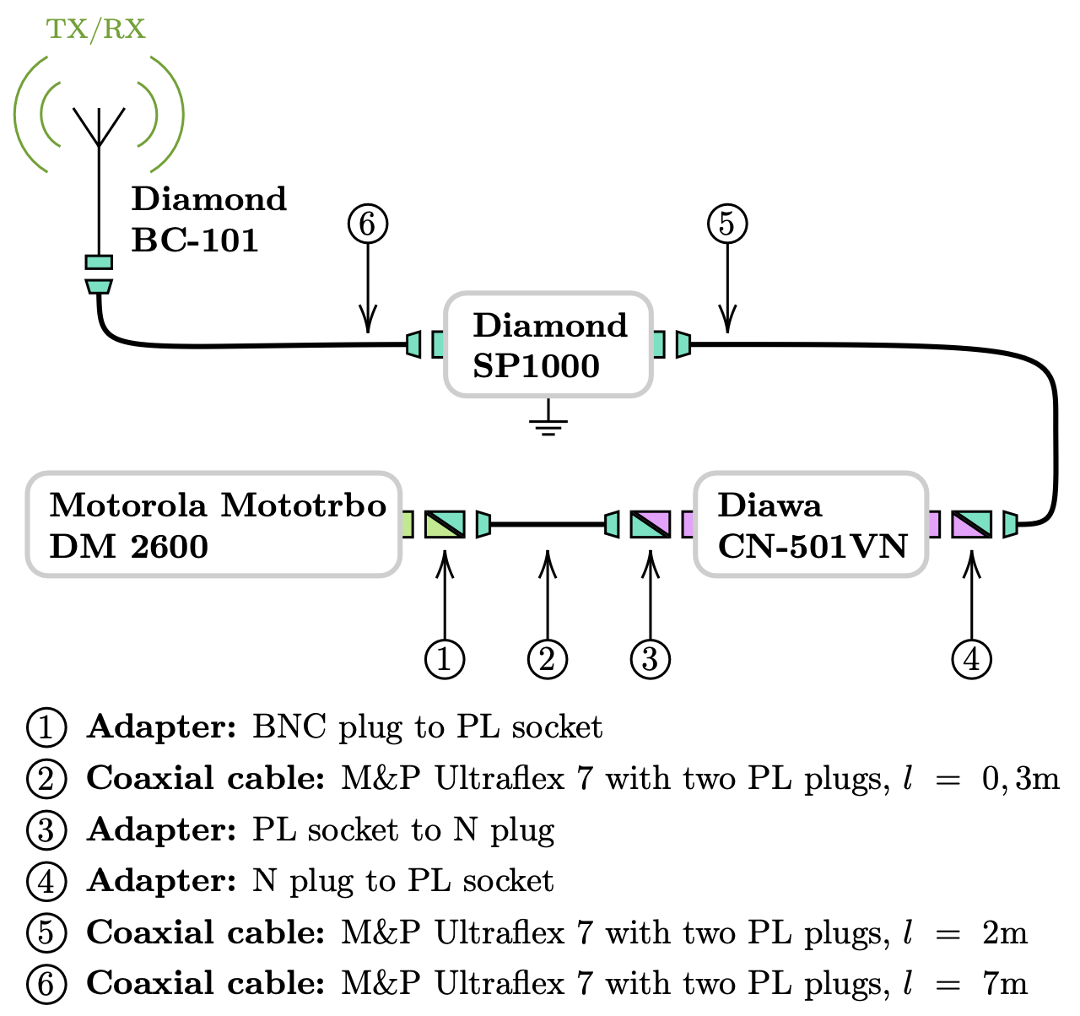
Voice communication system – Base station
Figure 5: Structure of the base station radio infrastructure.

Slide 10
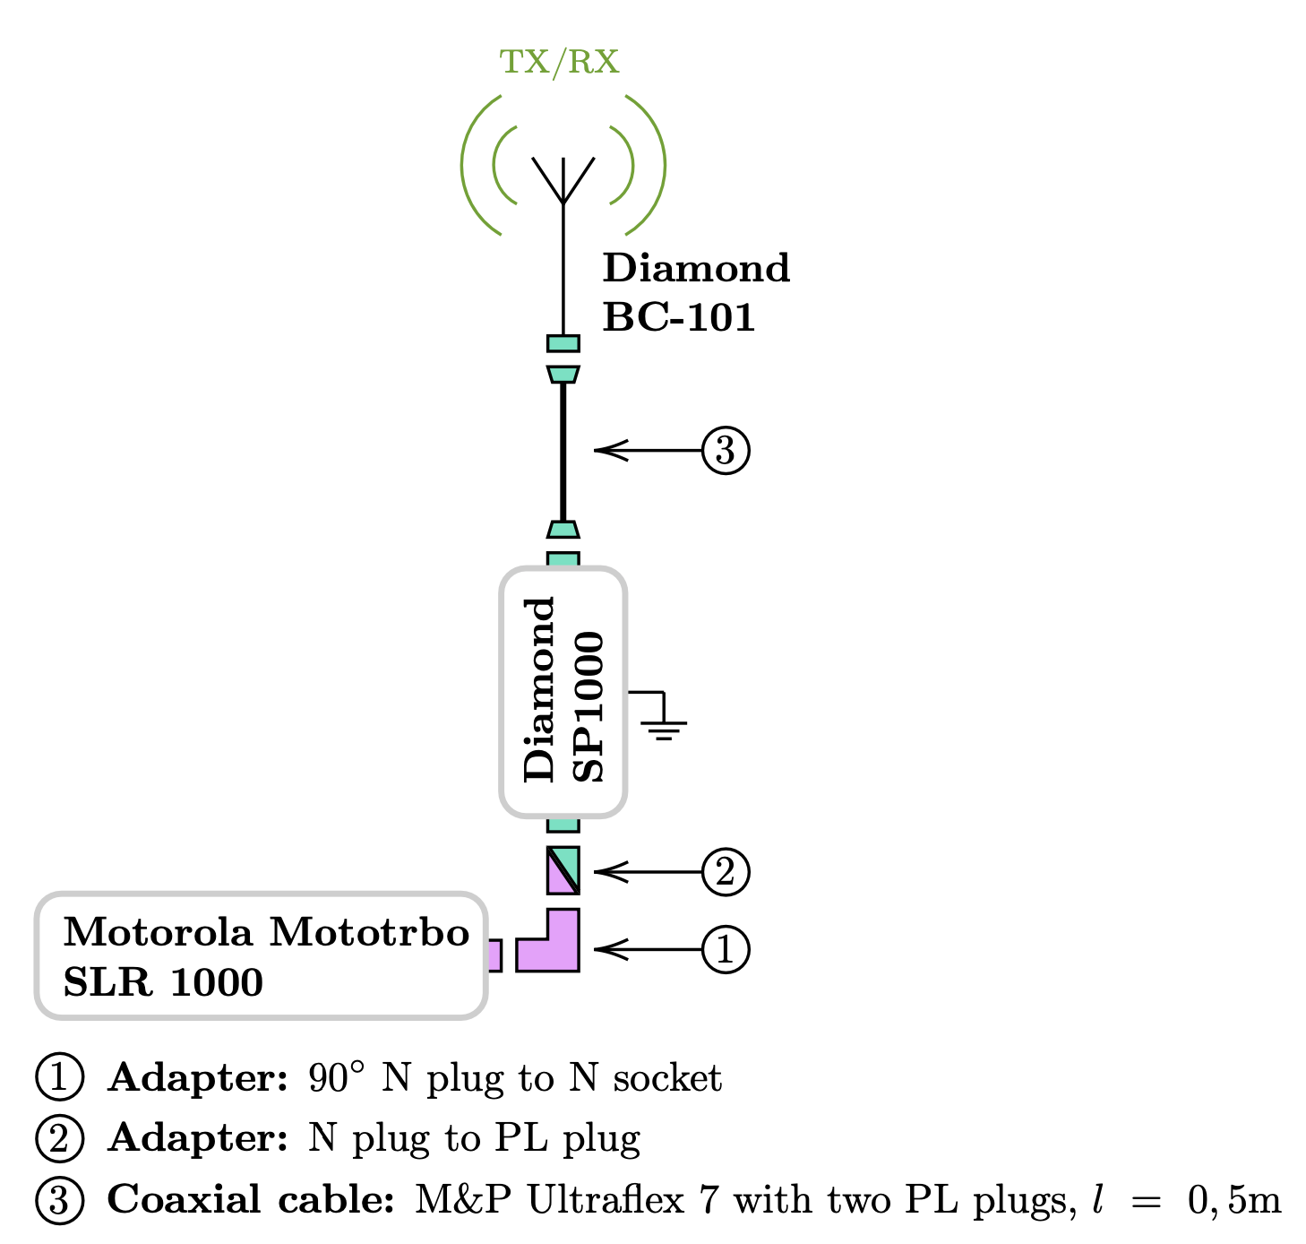
Voice communication system – Repeater
Figure 6: Structure of the repeater radio infrastructure.

Slide 11
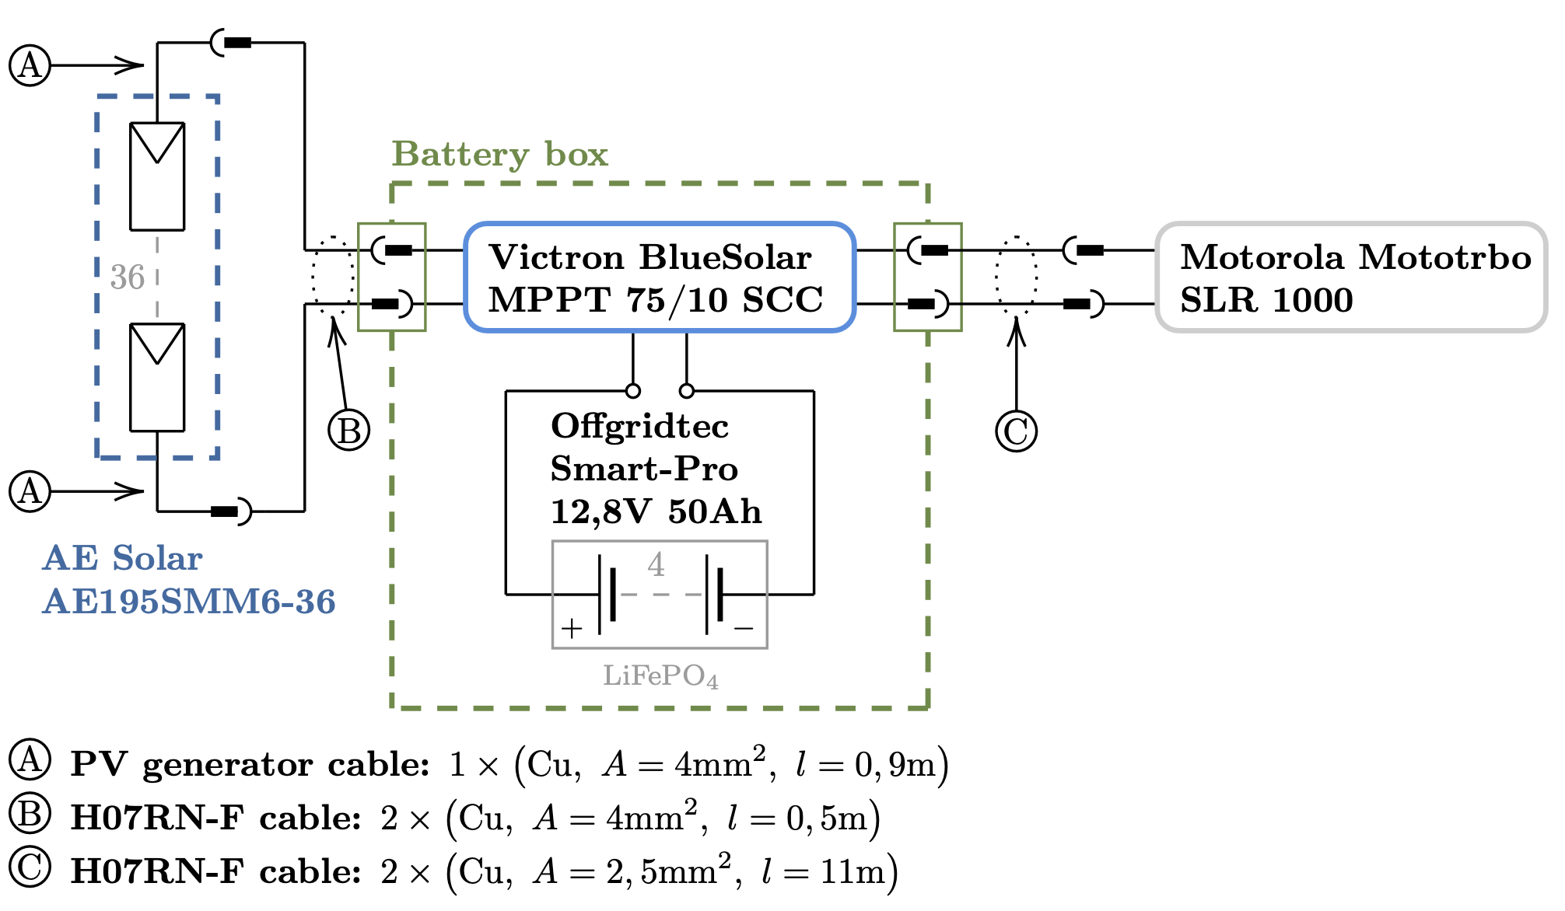
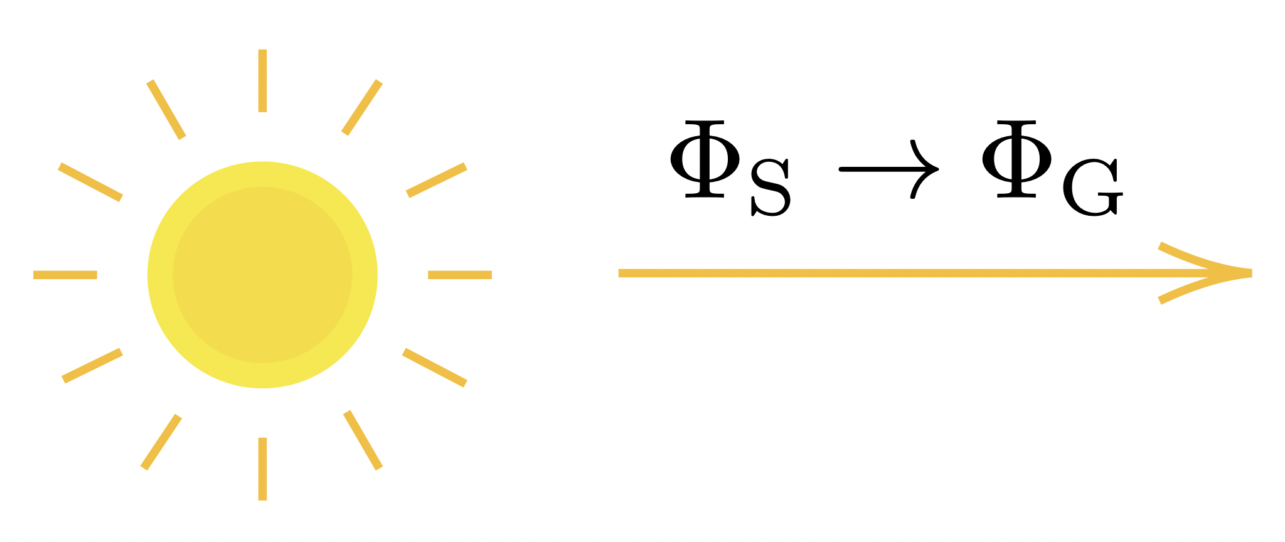
Self-suff. energy distribution system– Repeater
Figure 7: Structure of the self-sufficient energy distribution system of the
repeater radio infrastructure.

Slide 12
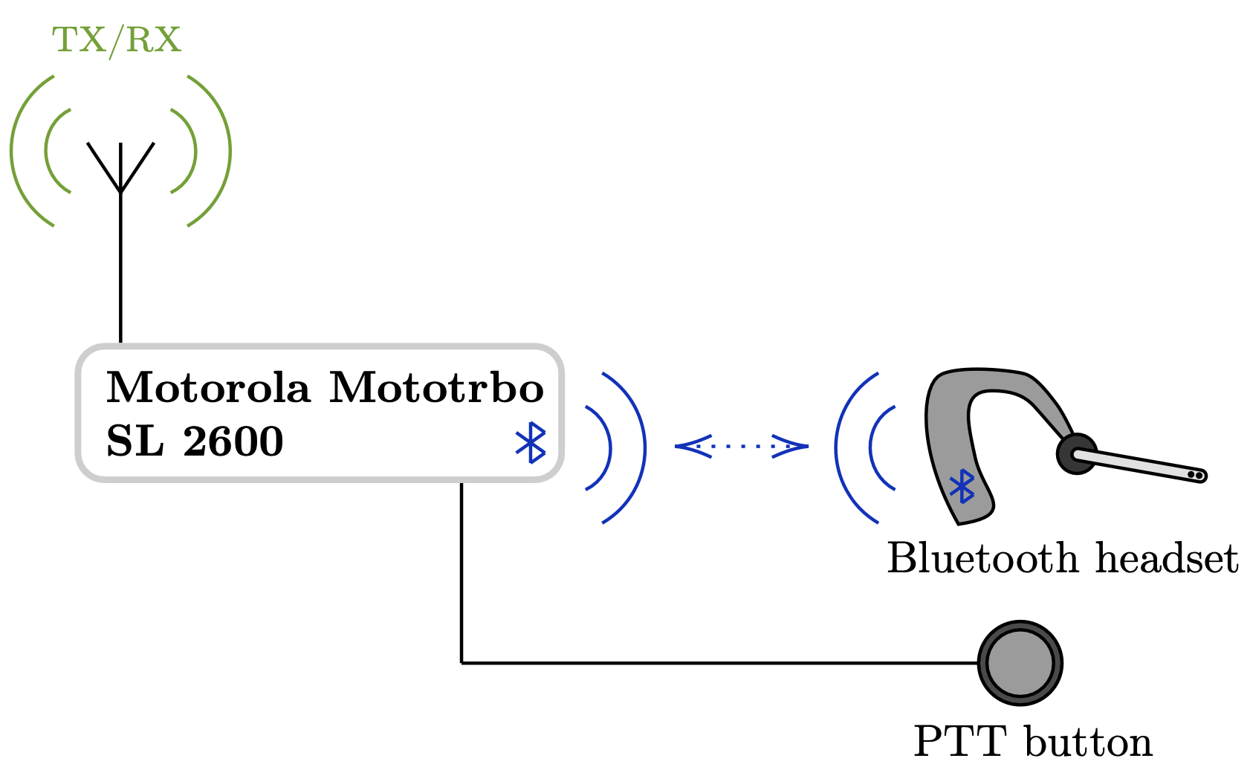
Voice communication system – Serenity
Figure 8: Structure of the Serenity radio system

Slide 13
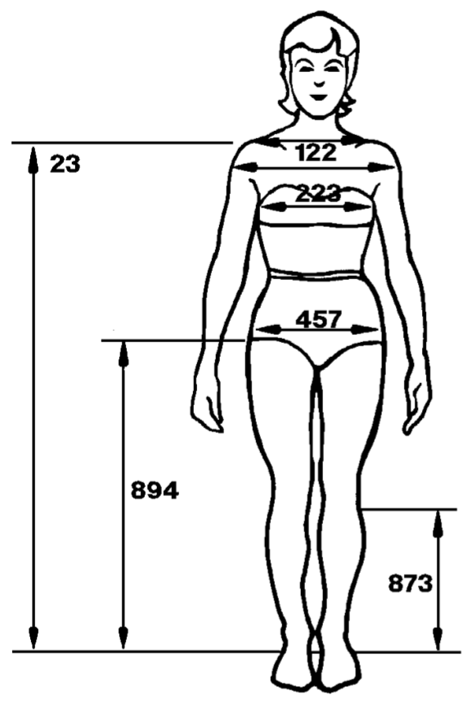

Voice communication system – OSS & SFTY
On-site support crew:
Motorola Mototrbo DP 3601 handheld radios
Safety officers:
Motorola Mototrbo SL 2600 handhald radios
Antenna height based on figure 6.
23 1,271m
Figure 9: ‘‘Body Size of
the 40-Year-Old Japanese
Female for Year 2000 in
One Gravity Conditions.’’
(Image and caption credit: [2])

Slide 14
Results – Serenity radio system
Device/Component | Operating temp. Requirements met?
Motorola Mototrbo SL 2600 | ✓
Third party audio jack | ?
Cables & connectors | ✓
PTT button (adopted from Aouda) | ✓
Jabra Storm Bluetooth headset | ?
Table 2: Serenity radio system version 1. Analysis of the operating temperature
within the HUT.
Dimension requirement met? ✓
Combined mass within the HUT: 853,33g
Combined mass requirement met? ?

Slide 15

Results – Fade margin
Ideal fade margin is above 20dB
Link | Fade margin
SER → REP | 23,319dB
SER ← REP | 28,548dB
OSS → REP | 23,841dB
OSS ← REP | 25,24dB
BSt → REP | 41,359dB
BSt ← REP | 37,38dB
SFTY → REP | 21,595dB
SFTY ← REP | 26,824dB
Link | Fade margin
SER → REP | 23,319dB
SER ← REP | 25,538dB
OSS → REP | 23,841dB
OSS ← REP | 22,23dB
BSt → REP | 34,37dB
BSt ← REP | 34,37dB
SFTY → REP | 21,595dB
SFTY ← REP | 23,841dB
Table 3: Max. transmission power
Table 4: 5W transmission power limit

Slide 16
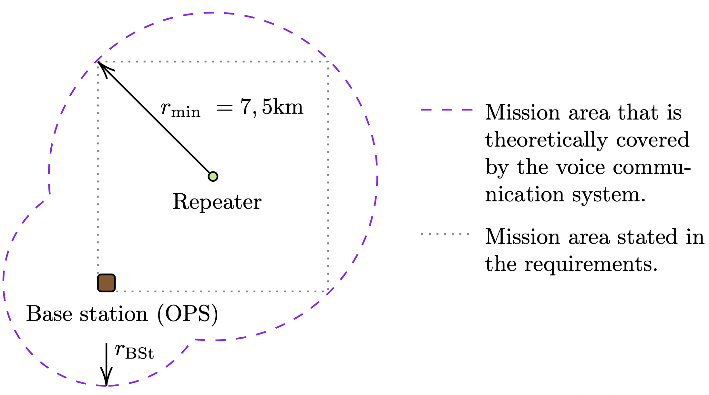

Results – Range
For fade margin 21,595dB
Figure 10: Illustration of the covered mission area.

Slide 17
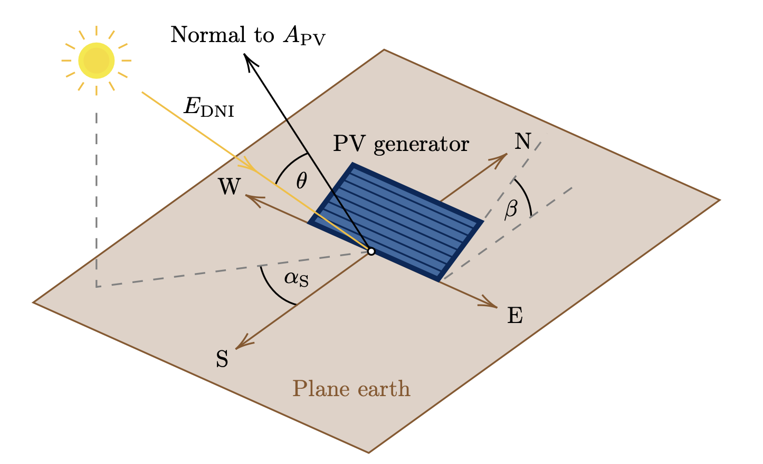
Results – Self-suff. energy distribution system
MATLAB simulation was developed which calculates:
Optimal inclination angle for each day
Optimal alignment for each day
Daily energy yield
If the battery gets fully charged
Verification for different locations possible:
AMADEE-20 in Israel in October ✓
Vienna in April ✓
Figure 11: Illustration of an installed PV generator.
(Recreated from: [3])

Slide 18
Martian application
Noise sources:
Thermal noise (worse heat convection due to thinner atmosphere)
Galactic noise picked up by VHF antennas
Man-made-noise caused by other missions on Mars
Link budget:
Multipath propagation based on topology
Maximizing range by reducing the amount of necessary infrastructure
Wave propagation and atmosphere:
Mars has almost no intrinsic magnetic field
Ionosphere as a reflector for VHF waves
Day: Global communication possible
Night: Effect is limited

Slide 19
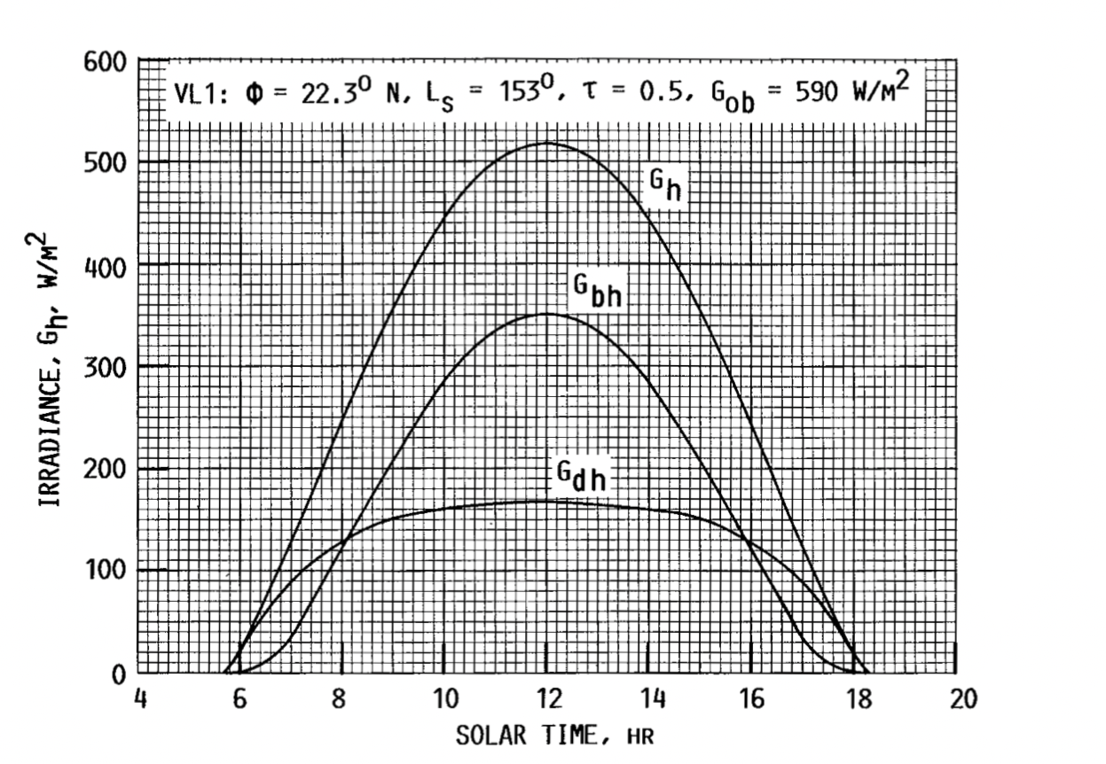

Martian application
Solar irradiance:
56,9% less solar irradiance (ob)
Due to greater distance to the Sun
Dust storms
Temperature:
Power output of PV generator strongly
depends on the PV cell temperature.
batteries have an operating
temperature from 5°C to 45°C.
Temp. control might be necessary.
Figure 12: Diurnal variation of global, beam
and diffuse irradiance on a horizontal Mars
surface at Viking Lander VL1.
(Image credit: [4])

Slide 20
Conclusion – Voice communcation system
Deliverables:
Design a backup voice communication system for the Serenity spacesuit simulator by taking table 1 into account. ✓ (?)
Investigate Martian application. ✓
Findings:
Plane earth propagation equation can be used to design such a system.
Repeater infrastructure is necessary for sufficiently large fade margin.
The Martian ionosphere can be used as a reflector for global communication during the day.
Temperature dependence of the devices and components must not be neglected.

Slide 21
Conclusion – Self-suff. energy distribution system
Deliverables:
If a repeater is necessary, design a self-sufficient energy distribution system for it. ✓
Carry out performance estimation based on the design. ✓
Investigate Martian application. ✓
Findings:
MATLAB simulation provides information of wether the repeater infrastructure can be operated
at a certain mission location on Earth.
Temperature dependence of the devices and components must not be neglected.

Slide 22
References
[1] National Aeronautics and Space Administration, Rock spire in ’spirit of st. louis crater’ on mars, Aug. 2017. [Online].
Available: https://www.nasa.gov/jpl/mer/pia19393/rock-spire-in-spirit-of-st-louis-crater-on-mars (visited on
04/13/2021).
[2] National Aeronautics and Space Administration, 3 anthropometry and biomechanics, Aug. 2020. [Online]. Available:
https://msis.jsc.nasa.gov/sections/section03.htm (visited on 04/13/2021).
[3] J. Appelbaum, I. Sherman, and G. Landis, “Solar radiation on mars: Stationary photovoltaic array,” NASA Technical
Memorandum, no. 106321, pp. 1–19, 1993.
[4] J. Appelbaum and D. J. Flood, “Solar radiation on mars,” NASA Technical Memorandum, no. 102299, pp. 1–31, 1989.

